Slide 1
Connecting a SharePoint list to a SQL table for CRUD ops
Eric J. Oszakiewski
MCTS: SharePoint Application Development SharePoint Configuration

Slide 2
Session Agenda
Overview of architecture
Creating the Secure Store Application
Understanding security between SharePoint & target DB
Creating the External Content Type
Modifying the Business Data Connectivity Model
Creating the SharePoint List
Demos throughout
Notes:
In this session, we will be covering an overview of the architecture needed to connect a list to a SQL table, which includes creating a Secure Store Application, understanding the security relationship between SP and your target DB, creating an External Content Type, modifying the auto-created BDC model, and creating the list automatically based on your External Content Type. There will be demos throughout.

Slide 3
About Me
Started programming in 1982 on IBM 3090 mainframes
Began with SharePoint in 2007 with WSS 2.0
MCTS: MOSS 2007 & SharePoint 2010 Application Development
Currently Enterprise Developer for Casino Arizona, also independent contractor
Twitter: @eoszak

Slide 4
Overview – Why Would We Do This?
Give users the ability to manage database content using a SharePoint list.
Control list access using multiple security models
Removes the burden of managing end-user data and places it back on them.
Provides a central place for users to access and modify their data.
Works in both SharePoint 2010 & 2013

Slide 5
Examples
Users need the ability to edit BI properties stored in a separate SQL table
Website administrators want to modify configuration data stored in a database but they can’t have access to the production server or content.
You want to give certain users ability to view data in a convenient way without granting them DB access.

Slide 6
Architecture
Preparation
SQL server/database name & account connecting to database
Ensure account has appropriate permissions
User account(s) who will be viewing/modifying the data
Which fields from SQL table you want to expose to the list
Which site the list will reside on

Slide 7
Secure Store Application
External Content Type
Set Object Permissions
Create Linked List

Slide 8
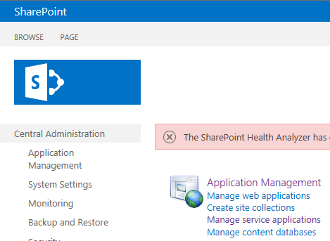
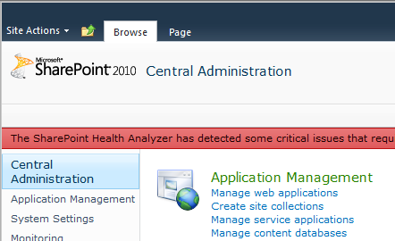
Secure Store Application
Replaced SSO in MOSS 2007
Navigate to Central Administration
Under Application Management, click Manage Service Applications
Notes:
SSA will be referred to in the future by the friendly name given during creation. This connection can also be used in InfoPath forms and Data Connections.

Slide 9
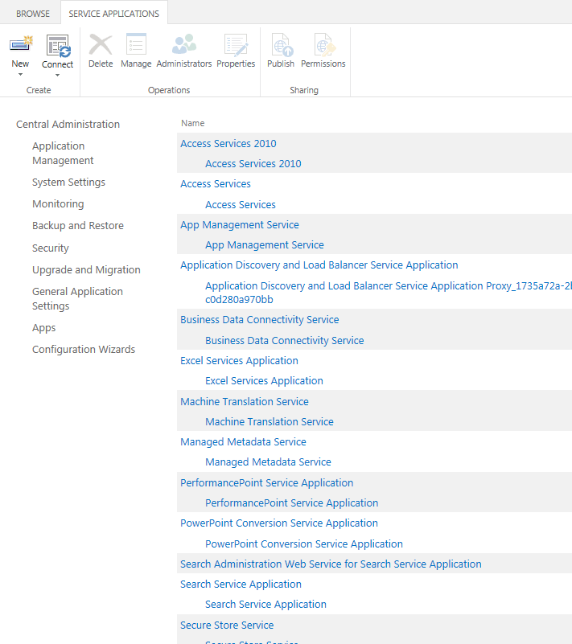
Secure Store Application
In Service Applications, click Secure Store Service
Notes:
Can also highlight the item and in the ribbon choose Manage

Slide 10
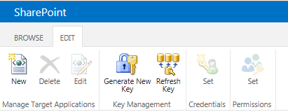
Secure Store Application
NOTE: You may be prompted to create a Key if you have not already. Follow the on-screen prompts to create the key before proceeding.
In the ribbon, under Manage Target Applications, click New

Slide 11
Secure Store Application
Target Application Settings
Application ID
Unique Identifier, but can be anything you want (text, numbers, both, no spaces)
Cannot be changed after creating target application
Display Name
Friendly name (spaces ok) to identify the connection

Slide 12
Secure Store Application
Target Application Settings
Contact E-mail
Primary contact for this application
Application Type
Individual Ticket – used for mapping each individual to a unique set of credentials on the external system, and can issue tickets that can be redeemed later.
Individual Restricted – same as individual ticket but has restricted access to the calling context. Recommended for SharePoint Online.
Individual – you only have one person who will be accessing this data
Group Ticket - used for mapping all members of one or more groups to a unique set of credentials on the external system, and can issue tickets that can be redeemed later
Group Restricted - same as group ticket but has restricted access to the calling context. Recommended for SharePoint Online
Group – you have more than one person who will be accessing this data
Cannot be changed after creating target application

Slide 13
Secure Store Application
Target Application Settings
Target Application Page URL
Custom login page
Disabled for any Group type selected
Display Name
Friendly name (spaces ok) to identify the connection

Slide 14
Secure Store Application
Credential Fields
Field Name – the internal name of the field you will be referencing (friendly)
Field Type
Generic- a value that does not fit into any other category
User Name – non-specific username (windows, SQL, etc)
PIN – a secret word or phrase
Key – a parameter that determines the functional output of a crypto algorithm or cipher
Windows User Name
Windows Password
Certificate (SP2013)
Certificate Password (SP2013)

Slide 15
Secure Store Application
Credential fields
Typically will only need username and password
Some application (ex: CRM) may require additional fields
CRM username
CRM password (masked)
CRM system number
CRM client number
Language
Use Add Field at the top to add/define more fields

Slide 16
Secure Store Application
Membership Settings
Target Application Administrators
Users who will have the ability to manage these settings, not necessarily the data
Should be domain admins, farm admins, network admins, etc.
Separate users with semicolons
Members
Users/groups mapped to the credentials defined for this application
Important: ONLY these individuals/groups will be able to access the data! Not even Farm admins can access the data if they’re not included here!

Slide 17
Understanding Security Between SharePoint and target DB
SSS DB username DB Password
SQL
SharePoint
OK to access

Slide 18
Secure Store Service
Set Application Credentials

Slide 19
Secure Store Application
Set Credentials
Username – this is the username of the account that will have access to the database.
Password
Confirm Password

Slide 20
Demo

Slide 21
Secure Store Application
External Content Type
Set Object Permissions
Create Linked List

Slide 22
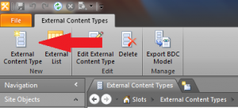
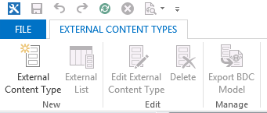
External Content Type
Open SharePoint Designer
Site Objects->External Content Types->External Content Type

Slide 23
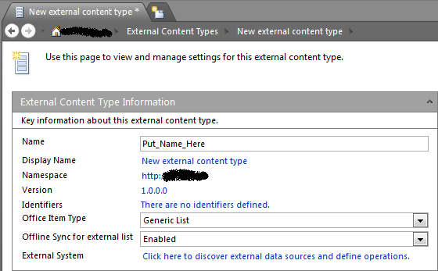
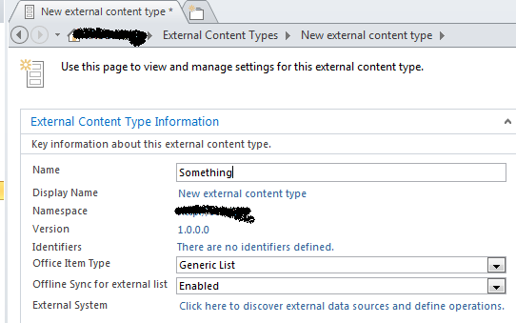
External Content Type
Choose a name for the External Content Type
Click link next to External System
External Content Type

Slide 24
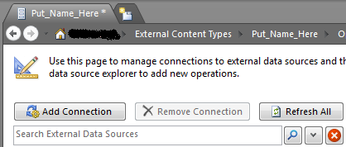
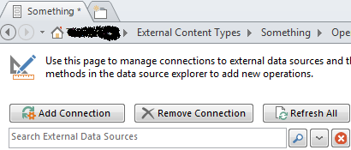
External Content Type
Click Add Connection

Slide 25
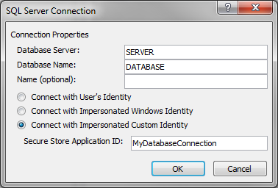
External Content Type
Database Server
Database Name
Choose Connect with Impersonated Custom Identity and enter the Secure Store Application name

Slide 26
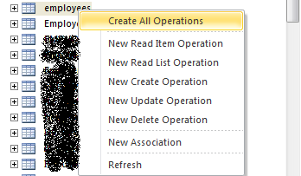
External Content Type
Expand table listing and locate the desired table. Right-click and choose the desired CRUD method(s)

Slide 27
External Content Type
CRUD methods
Read Item (Specific Finder): Used for returning information from a single list item based on passed-in parameter(s)
Read List (Finder): Used for returning multiple entity instances. Providing filter criteria and returning list items.
Create: Allows the user to create list items
Update: Allows the user to update existing list items
Delete: Allows the user to delete existing list items

Slide 28
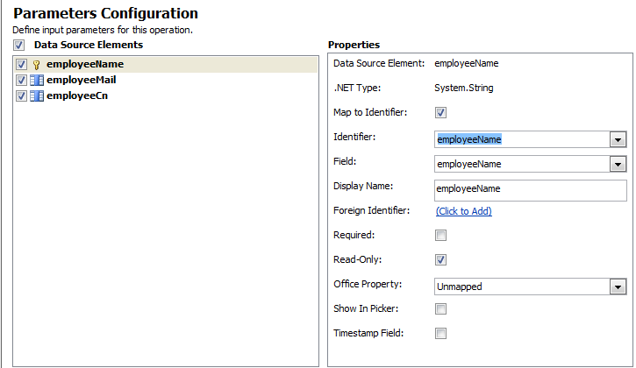
External Content Type
Parameters Configuration
Choose which fields from the database will be exposed and how
Choose an identifier (primary key)
Required? Read Only?
Click Finish when done
Click Save at top.
Notes:
Check “Map to Identifier” if you’re mapping this column to the given identifier from the database. If you’d rather map it to an Outlook property, leave it unchecked and choose the Office Property at the bottom to map it to – also check “Show in Picker” so users can change it later if desired.
Note: on the next page (if you choose to filter results), you can filter results. If you’re setting a Limit Filter, limiting the # of rows returned, enter a number less than 2000. Anything more than 2000 and BDC will throttle the results, ending up in not returning anything. If you need more than 2000 results and still want to limit the # returned, change the default throttling value on the server, which is in Central Admin, under Application Management->Manage web applications->General Settings->Resource Throttling

Slide 29
Demo

Slide 30
Secure Store Application
External Content Type
Set Object Permissions
Create Linked List

Slide 31
Set Object Permissions
Central Administration
Manage Applications->Manage Service Applications
Locate BDC service and click the link
Find your newly created service (created when External Content Type was created), check the box next to it and click Set Object Permissions

Slide 32
Set Object Permissions
Central Administration
Enter all names or groups who will need access to this database resource & click Add
Set item permissions on each. At least one must have Set Permissions.

Slide 33
Demo

Slide 34
Secure Store Application
External Content Type
Set Object Permissions
Create Linked List

Slide 35
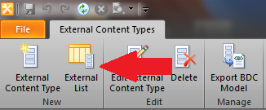
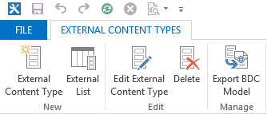
Create Linked List
SharePoint Designer
Site Objects->External Content Type
Locate newly created External Content Type and click it once to select, then click External List at the top.
Enter name and description (optional) and click OK.

Slide 36
Demo

Slide 37
Review
Creating the Secure Store Application
Understanding security between SharePoint & target DB
Creating the External Content Type
Modifying the Business Data Connectivity Model
Creating the SharePoint List

Slide 38
Questions?

Slide 39
Resources
Twitter: @eoszak Blog: http://eoszak.me/speric Email: eric@oszakiewski.net
MSDN: Use Secure Store Service to Connect to an External System http://msdn.Microsoft.com/en-us/library/ee554863(v=office.14).aspx
Implementing Stereotyped Operations in Your Methods (CRUD) http://msdn.Microsoft.com/en-us/library/ff464422(v=office.14).aspx
Blog: Connecting a SharePoint 2010 list to an external database table http://eoszak.me/11gUsPF
Download this slide deck: http://eoszak.me/spsatpres
Thank you!

