Slide 1
Make Your DBA Happy: 5 Habits Developers Can Implement Today
Eric Oszakiewski, MCTS, MS, MCPS

Slide 2
Agenda
5 Habits
Database construction & housekeeping
Application habits
What happens when we assume?
Bridging the role gap
Relationships

Slide 3
About Me
Started programming in 1982 on IBM 3088/3090 mainframes
First used SQL in 2006 (SQL 2000)
Currently .Net/SharePoint Software Developer for General Motors, also independent contractor
Twitter: @eoszak

Slide 4
Database Construction & Housekeeping
Indexes
Data types
Recovery models & logging
Queries vs. Views
SELECT * and DISTINCT

Slide 5
Indexes
Pre-materialize a sort over the data
Speeds up SORT BY criteria in queries
Enable seeks for particular values
Seeks are better than Scans. Scans increase the number of locks dramatically & may be held longer depending on query runtime
Query Analyzer & Execution Plan
Demo – Execution Plan
Notes:
Think of an index as an organized snapshot of your data
Future queries can use this index because it’s pre-sorted based on the sort by conditions you gave it when you created the index
Look at live demo

Slide 6
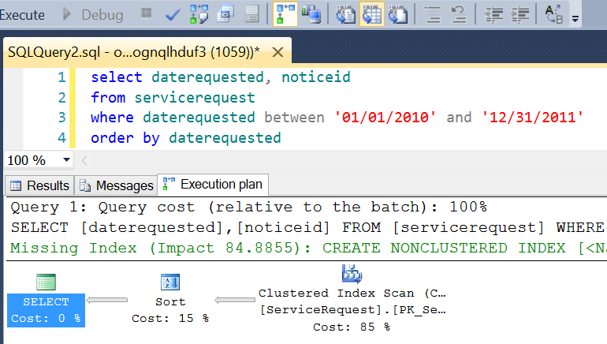
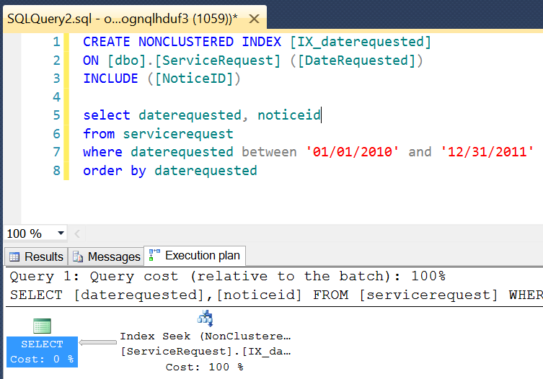
Indexes

Slide 7
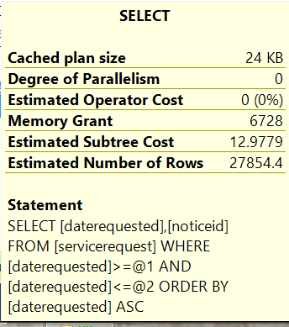
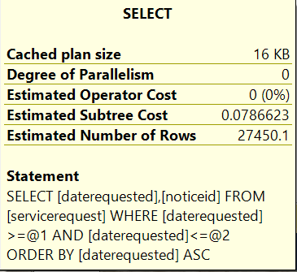
Indexes
Notes:
A unitless measure of overall cost
A good place to start, but is by no means the absolute measurement
With experience, you should begin considering duration, CPU and I/O

Slide 8
Indexes
Indexes need maintenance too!
Like running DEFRAG on a PC
REBUILD or REORGANIZE
Rebuild
good for regularly scheduled downtime
brand new index every time
time consuming
Reorganize
more lightweight
doesn’t require massive rollback if canceled, just stops where it is
When adding indexes to dev tables/views, let DBA know so he/she can manage rebuilds/reorgs.

Slide 9
Data Types
Impact of selecting improper data types
Significant performance implications
Wasted space and IO
Beware Unicode Data Types.

Slide 10
Data Types
Data Type | Values Stored | Storage Requirements
bit | 0,1 | 1 byte per 8 bits
tinyint | 0 to 255 | 1 byte
smallint | Up to 32,767 | 2 bytes
int | Up to 2,147,483,647 | 4 bytes
bigint | Up to 9,223,372,036,854,775,807 | 8 bytes
smalldatetime | 1900-01-01 to 2079-06-06, minute precision | 4 bytes
datetime | 1753-01-01 to 9999-12-31, sub-second precision | 8 bytes

Slide 11
Data Types
Example 1: CREATE TABLE myTable ( pkid INT IDENTITY(1,1) , aNum INT , aDate DATETIME CONSTRAINT PK_myTable PRIMARY KEY CLUSTERED (pkid) );
Bytes per row = 4 (pkid) + 4 (aNum) + 8 (aDate) + 9 = 25 bytes
Rows per data page = 8096 / 25 = 323 rows
Pages per 1M rows = 1000000 / 323 = 3096 pages
Example 2: CREATE TABLE myTable ( pkid INT IDENTITY(1,1) , aNum TINYINT , aDate SMALLDATETIME CONSTRAINT PK_myTable PRIMARY KEY CLUSTERED (pkid) );
Bytes per row = 4 (pkid) + 1 (aNum) + 4 (aDate) + 9 = 18 bytes
Rows per data page = 8096 / 18 = 449 rows
Pages per 1M rows = 1000000 / 449 = 2228 pages
Saving 27% space, a single IO can return an extra 126 rows, IO improves by 39%

Slide 12
Data Types
Unicode vs non-Unicode
Storing special characters
Unicode requires 2x the storage as non-Unicode
VARCHAR(300) = 300 bytes/row (non-Unicode)
NVARCHAR(300) = 600 bytes/row (Unicode)
For 10M rows, NVARCHAR requires 3GB more space than VARCHAR
NVARCHAR, NCHAR and NTEXT should only be used in columns with international text
Each has its application:
Front-end website?
Back-office data management?

Slide 13
Recovery Models & Logging
Simple
No log backups
Automatically reclaims log space to keep space requirements small
Eliminates need to manage T-Log space
Changes since the most recent backup are unprotected
Full
Requires log backup
No work is lost due to a lost or damaged data file
Can recover to a specific point in time, assuming that your backups are complete up to that point in time.

Slide 14
Recovery Models & Logging
Most important: Let DBA know which model you chose!
Not setting T-Log backups regularly on a Full Recovery model will result in the T-Log continually growing.
Free space issues
Performance problems.

Slide 15
Queries vs. Views
Put complex queries into stored procedures/views as opposed to putting in application or website
Consider performance implications/benefits of putting large queries into Views
Can index views (remember to maintain the index!)
Common Table Expressions (CTE) and sub-selects are useful, but not always the answer.

Slide 16
SELECT datekey, dayofweeknum, DAY(DATEADD(DAY, - 1, DATEADD(MONTH, 1, DATEADD(DAY, - (DAY([date])) + 1, [date])))) daysinmonth, fiscalmonthid, (fiscalmonthid - 100)
dailyfiscalmonthid
/*ID for the Prior Year, Same Month*/ FROM edwshared.dbo.tbldimdate),
/*The AVERAGE value of measures across each day of the week in the entire month, this is the historical performance data (actuals)*/ daily AS
(SELECT dates.fiscalmonthid, dates.dayofweeknum, aud.propertykey,
aud.slotfinancedenominationkey/*DECIMAL(27,11) was chosen to support MONEY datatype (19,4) with maximum precision while still supporting SQL Precision + Scale = 38 Best Pratice*/ ,
CAST(AVG(aud.coinin) AS DECIMAL(27, 11)) coinin
FROM dates INNER JOIN
(SELECT datekey, propertykey,
slotfinancedenominationkey/*DECIMAL(27,11) was chosen to support MONEY datatype (19,4) with maximum precision while still supporting SQL Precision + Scale = 38 Best Pratice*/ ,
CAST(NULLIF (SUM(coinin), 0) AS DECIMAL(27, 11)) coinin
FROM vwfactslotaudited
GROUP BY datekey, propertykey, slotfinancedenominationkey) aud ON dates.datekey = aud.datekey
GROUP BY dates.fiscalmonthid, dates.dayofweeknum, propertykey, slotfinancedenominationkey),
/*The budget for each month at the grain it is assigned in the GL (Month/Property typically, occassionally an extra Dimension field is used)*/ budget AS
(SELECT fiscalmonthid, propertykey, slotfinancedenominationkey, [COININ] coinin, [DROP] [drop], [PAIDOUT] paidout, [MACH] machinecount
FROM (SELECT DISTINCT
dates.fiscalmonthid, ISNULL(acct.propertykey, - 2) propertykey, CASE WHEN pvt.dimensionmap IS NULL
THEN - 2 WHEN denom.slotfinancedenominationkey IS NULL THEN - 1 ELSE denom.slotfinancedenominationkey END slotfinancedenominationkey,
pvt.measure, b.budget * pvt.transactionmultiplier monthlybudget
FROM tbldimaccount acct INNER JOIN
map.tbllkpaccountpivot pvt ON acct.accountnumber = pvt.accountnumber LEFT OUTER JOIN
tbldimslotfinancedenomination denom ON pvt.dimensionmap = denom.financedenommap INNER JOIN
tblfactaccountmonthlybudget b ON acct.accountkey = b.accountkey INNER JOIN
dates ON b.datekey = dates.datekey
WHERE pvt.department = 'Slot' AND pvt.measure IN ('COININ', 'DROP', 'PAIDOUT', 'MACH')) b PIVOT (SUM(monthlybudget) FOR measure IN ([COININ], [DROP],
[PAIDOUT], [MACH])) pvt), /*Dividing up the monthly budgets by historical day of week performance*/ breakdown AS
(SELECT dates.datekey, budget.propertykey,
budget.slotfinancedenominationkey/*These calculations are in the format: ( Measure Historical Day of Week Total / Measure Historical for Budget Month Total) * Current Monthly Budget*/ ,
CASE WHEN ISNULL(budget.coinin, 0) = 0 THEN budget.coinin /*No budget, pass back budget value (NULL or 0)*/ WHEN ISNULL(SUM(daily.coinin)
OVER (PARTITION BY budget.fiscalmonthid, budget.propertykey, budget.slotfinancedenominationkey), 0)
= 0 THEN budget.coinin / daysinmonth /*No Historical data for the entire month, divide up budget evenly between all days*/ WHEN ISNULL(daily.coinin, 0)
= 0 THEN 0 /*No daily historical data, pass back daily value (NULL or 0)...Maybe hard-code 0, may not want a NULL in this situtation*/ ELSE (daily.coinin / SUM(daily.coinin)
OVER (PARTITION BY budget.fiscalmonthid, budget.propertykey, budget.slotfinancedenominationkey))
* budget.coinin /*Otherwise enough data to split budget cross the days of week*/ END coininbudget, CASE WHEN ISNULL(budget.[drop], 0)
= 0 THEN budget.[drop] /*No budget, pass back budget value (NULL or 0)*/ WHEN ISNULL(SUM(daily.coinin) OVER (PARTITION BY budget.fiscalmonthid,
budget.propertykey, budget.slotfinancedenominationkey), 0)
= 0 THEN budget.[drop] / daysinmonth /*No Historical data for the entire month, divide up budget evenly between all days*/ WHEN ISNULL(daily.coinin, 0)
= 0 THEN 0 /*No daily historical data, pass back daily value (NULL or 0)...Maybe hard-code 0, may not want a NULL in this situtation*/ ELSE (daily.coinin / SUM(daily.coinin)
OVER (PARTITION BY budget.fiscalmonthid, budget.propertykey, budget.slotfinancedenominationkey))
* budget.[drop] /*Otherwise enough data to split budget cross the days of week*/ END dropbudget, CASE WHEN ISNULL(budget.paidout, 0)
= 0 THEN budget.paidout /*No budget, pass back budget value (NULL or 0)*/ WHEN ISNULL(SUM(daily.coinin) OVER (PARTITION BY budget.fiscalmonthid,
budget.propertykey, budget.slotfinancedenominationkey), 0)
= 0 THEN budget.paidout / daysinmonth /*No Historical data for the entire month, divide up budget evenly between all days*/ WHEN ISNULL(daily.coinin, 0)
= 0 THEN 0 /*No daily historical data, pass back daily value (NULL or 0)...Maybe hard-code 0, may not want a NULL in this situtation*/ ELSE (daily.coinin / SUM(daily.coinin)
OVER (PARTITION BY budget.fiscalmonthid, budget.propertykey, budget.slotfinancedenominationkey))
* budget.paidout /*Otherwise enough data to split budget cross the days of week*/ END paidoutbudget, budget.machinecount machinecountbudget
FROM dates INNER JOIN
budget ON dates.fiscalmonthid = budget.fiscalmonthid LEFT OUTER JOIN
daily ON dates.dailyfiscalmonthid = daily.fiscalmonthid AND dates.dayofweeknum = daily.dayofweeknum AND budget.propertykey = daily.propertykey AND
budget.slotfinancedenominationkey = daily.slotfinancedenominationkey)
/*Perform calculations and CAST datatypes to match audited views column structure*/ SELECT [DateKey], [PropertyKey], [SlotFinanceDenominationKey],
CAST(coininbudget AS MONEY) [CoinInBudget], CAST(dropbudget AS MONEY) [DropBudget], CAST(paidoutbudget AS MONEY)
[PaidOutBudget]/*If ALL fields used in the calculation are NULL, return NULL*/ , CASE WHEN COALESCE (dropbudget, paidoutbudget) IS NULL THEN NULL
ELSE CAST(ISNULL(dropbudget, 0) - ISNULL(paidoutbudget, 0) AS MONEY) END [GrossWinBudget], CAST(machinecountbudget AS INT) [MachineCountBudget],
'SLOT' [Department]
FROM breakdown

Slide 17
Queries vs. Views
SELECT DateKey, PropertyKey, Department
FROM ThatQueryTurnedIntoAView
Provides centrally managed dataset
Allows DBA and Developer to communicate effectively with regards to changes
Eliminates the need to hunt through code for potential impact.

Slide 18
SELECT * and DISTINCT
SELECT *
Shorthand for “get all columns”
Useful for grabbing an immediate result for review/analysis
Common mistake
INSERT INTO table SELECT * FROM anotherTable
Originating columns could change, or columns could be added/dropped, resulting in an error
SELECT * will return ALL columns from that table, but if you want all columns, list them.

Slide 19
SELECT * and DISTINCT
SELECT DISTINCT
Will return unique rows based on columns specified
Also shorthand-style like SELECT * is
Ask yourself why you are using DISTINCT, if the answer is because you’re getting duplicates in your results, consider GROUP BY instead
Is a table improperly defined and there is actually duplicate data? This could be a serious problem that’s being missed by using DISTINCT!
Does the query simply need additional filter or group criteria?
Grouping and filtering (and proper joins) may provide the same results more efficiently.
DISTINCT & GROUP BY essentially doing the same thing performance-wise. However, GROUP BY is recommended over DISTINCT.

Slide 20
Database Construction & Housekeeping
Review
Indexes – use them and maintain them!
Data types – improve performance & storage by choosing wisely
Recovery models & logging – your selection will impact more than just your database
Queries vs. Views – put those complex queries into views
SELECT * and DISTINCT – know when to use each

Slide 21
Application Habits
Managing connections/sessions
Type safety/input sanitization.

Slide 22
Managing Connections/Sessions
Ensure database connections are closed when no longer needed
con.Open(); cmd.ExecuteNonQuery(); con.Close();
If something happens on line 2, the connection could get left open indefinitely.

Slide 23
Managing Connections/Sessions
try { con.Open(); cmd.ExecuteNonQuery(); } catch(SqlException se) { // do something } finally { con.Close(); }
Now if something bad happens the connection will be closed, because the finally statement always runs, even on error.

Slide 24
Type safety/input sanitization
Ensure proper data type is being passed to database
Best practice for preserving data integrity and preventing SQL injection
Data type should be consistent from application to query to database
Use stored procedures instead of leaving query in code.

Slide 25
Type safety/input sanitization
Best practice recommendation
Scope input field with specific data type
Use desired validation on fields
Call parameterized stored procedure
Handle errors in friendly manner
Prevents improper data insertion
Empowers user to enter correct info, double check entry, correct mistakes.
Notes:
This is your website or client UI, where users input their values. Use type validation here, either client side or server side, then pass that to a parameterized sproc in the code. The stored procedure will be expecting specific data types and if they don’t match will break.

Slide 26
Application Habits
Review
Managing connections/sessions – make sure they’re closed properly
Type safety/input sanitization – protect your data’s security & integrity.

Slide 27
What Happens When We Assume?
Common assumptions
Resources are abundantly available
The DBA knows what I’m doing
I don’t need a dev/test environment, it’s working fine.

Slide 28
Resources are abundantly available
No, they’re not
Even with VM environment, scalable architecture, plenty of CPU/RAM/HD space, an application that makes poorly-performing database calls or leaves connections open will consume resources
Adding hardware to a poorly performing application is not the answer, look for ways to optimize queries, refactor code, close connections first
Work with DBA to analyze database to assist with locating problems
Debug/Assert/Trace code to find optimization opportunities.
Notes:
Also consider tools like Resharper or Code Maid

Slide 29
The DBA knows what I’m doing
No, they don’t
Communicate what you’re wanting to do, even if they are aware they will appreciate the communication over redundancy.

Slide 30
I don’t need a dev/test environment
Yes, you do
“It worked on my machine…”
Try to have a dev/test environment as close to prod as possible, identical would be best, including SP, CU, Hotfixes, patches, etc
Comment stored procedures, views thoroughly so DBA and others know what was intended. This can help with troubleshooting or determining what is affected when changes are needed.

Slide 31
What Happens When We ASS-U-Me?
Review
Resources are *not* abundantly available, and if you are told they are code as if they are not
The DBA is *not* clairvoyant
You most definitely need a dev/test environment of some kind.

Slide 32
Bridging the Role Gap
Developer –> DBA or SysAdmin –> DBA?
Typically DBAs are former SysAdmins or former Developers
Learn the background of your DBA(s), keep open communication regarding skills and abilities.

Slide 33
Relationships
Be humble – the DBA doesn’t know everything and neither do you
Ask questions when unclear, it’s not a sign of weakness
No demanding resources
Ask for help with logging during testing or troubleshooting
Be willing to teach a little, and you might learn something.

Slide 34
Review
Database construction & housekeeping
Proper data types, indexes, recovery models, SELECT *, DISTINCT
Application habits
Type safety & input sanitization
What happens when we assume?
Infinite resources, communication with DBA
Bridging the role gap
Knowing skillset, communication with DBA
Relationships
Communication with DBA

Slide 35
Questions?

Slide 36
Thank you Sponsors!

Slide 37
Thank you!
References
http://www.brentozar.com/archive/2013/09/index-maintenance-sql-server-rebuild-reorganize/
http://sqlfool.com/content/PerformanceConsiderationsOfDataTypes.pdf
https://www.simple-talk.com/sql/t-sql-programming/ten-common-sql-programming-mistakes/
Download slide deck: http://eoszak.me/sqlsat279ppt
Twitter: @eoszak Blog: http://oszak.com Email: eric@oszakiewski.net

